Slide 1
Confluence: Conformity Influence in Large Social Networks
Jie Tang*, Sen Wu*, and Jimeng Sun⁺
*Tsinghua University
⁺IBM TJ Watson Research Center

Slide 2
Conformity
Conformity is the act of matching attitudes, opinions, and behaviors to group norms.^{[1]}
Kelman identified three major types of conformity^{[2]}
  Compliance is public conformity, while possibly keeping one's own original beliefs for yourself.
  Identification is conforming to someone who is liked and respected, such as a celebrity or a favorite uncle.
  Internalization is accepting the belief or behavior, if the source is credible. It is the deepest influence on people and it will affect them for a long time.
[1] R.B. Cialdini, & N.J. Goldstein. Social influence: Compliance and conformity. Annual Review of Psych., 2004, 55, 591–621.
[2] H.C. Kelman. Compliance, Identification, and Internalization: Three Processes of Attitude Change. Journal of Conflict Resolution, 1958, 2 (1): 51–60.
Notes:
Compliance is public conformity, while possibly keeping one's own original beliefs for yourself. Compliance is motivated by the need for approval and the fear of being rejected.
Identification is conforming to someone who is liked and respected, such as a celebrity or a favorite uncle. This can be motivated by the attractiveness of the source,[11] and this is a deeper type of conformism than compliance.
Internalization is accepting the belief or behavior and conforming both publicly and privately, if the source is credible. It is the deepest influence on people and it will affect them for a long time.

Slide 3
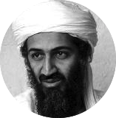


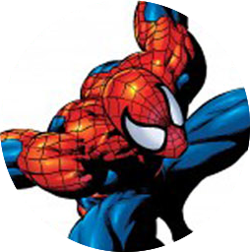

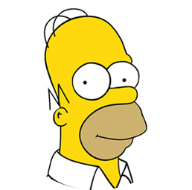
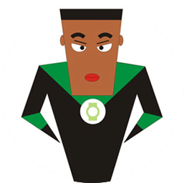
“Love Obama”
I love Obama
I hate Obama, the worst president ever
Obama is fantastic
Obama is great!
No Obama in 2012!
He cannot be the next president!
Positive
Negative
Notes:
Obama has done just that. From social networking to his blog to his Fight the Smears campaign, Obama has made his Web 2.0 presence known. He has over 1.5 million friends on MySpace and Facebook, and he currently has over 28,000,000 followers on Twitter. This personal activity in social networks allows him to quickly get the word out across multiple platforms.

Slide 4
Conformity Influence Analysis
I love Obama
3. Group conformity
Obama is fantastic
A
Obama is great!
D
1. Peer conformity
2. Individual conformity
C
B
Positive
Negative

Slide 5
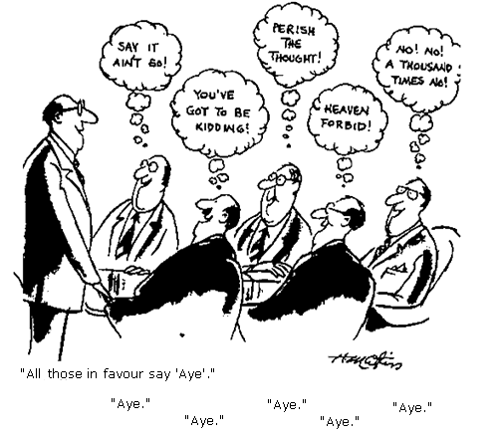
Related Work—Conformity
Conformity theory
  Compliance, identification, and internalization [Kelman 1958]
  A theory of conformity based on game theory [Bernheim 1994]
Influence and conformity
  Conformity-aware influence analysis [Li-Bhowmick-Sun 2011]
Applications
  Social influence in social advertising [Bakshy-el-al 2012]
Notes:
Conformity was first studied by psychologists through interviews with small groups of participants [17]. In economics, Bernheim [3] found that sometimes people are willing to conform simply because they recognize that departure from the social norm may impair their status. Bernheim further proposed a theory of social conformity and presented a model to describe the conformity process. However, due to the lack of real data, he only studied the model from the theoretical aspect.
Correlation between influence and individual conformity

Slide 6
Related Work—social influence
Influence test and quantification
  Influence and correlation [Anagnostopoulos-et-al 2008] Distinguish influence and homophily [Aral-et-al 2009, La Fond-Nevill 2010]
  Topic-based influence measure [Tang-Sun-Wang-Yang 2009, Liu-et-al 2012] Learning influence probability [Goyal-Bonchi-Lakshmanan 2010]
Influence diffusion model
  Linear threshold and cascaded model [Kempe-Kleinberg-Tardos 2003]
  Efficient algorithm [Chen-Wang-Yang 2009]
Notes:
From a broader viewpoint, conformity can be seen as a special type of social influence. There are a bulk of studies on social influence analysis. These studies can be roughly classified into three categories: influence testing [1, 9, 20], influence quantification [12, 13, 23, 32], and influence maximization models [6, 18]. However, most of the works focus on qualitative study of social influence.
However, they do not distinguish the effect of peer influence and group conformity.

Slide 7
Challenges
How to formally deﬁne and differentiate different types of conformities?
How to construct a computational model to learn the different conformity factors?
How to validate the proposed model in real large networks?

Slide 8
Problem Formulation and Methodologies

Slide 9
Four Datasets
Network | #Nodes | #Edges | Behavior | #Actions
Weibo | 1,776,950 | 308,489,739 | Tweet on popular topics | 6,761,186
Flickr | 1,991,509 | 208,118,719 | Comment on a popular photo | 3,531,801
Gowalla | 196,591 | 950,327 | Check-in some location | 6,442,890
ArnetMiner | 737,690 | 2,416,472 | Publish in a specific domain | 1,974,466
All the datasets are publicly available for research.

Slide 10
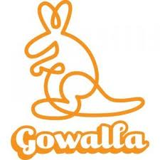
A concrete example in Gowalla
Legend
Alice
Alice’s friend
Other users
1’
1’
1’
1’
If Alice’s friends check in this location at time t
Will Alice also check in nearby?

Slide 11



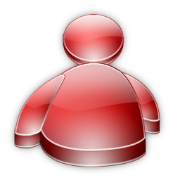
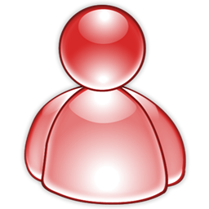
Notations
Time t
Node/user: v_{i}
User Group: c_{ij}
Time t-1, t-2…
Attributes: x_{i}
- location, gender, age, etc.
Action/Status: y_{i}
- e.g., “Love Obama”
G =(V, E, C, X)
— each (a, v_{i}, t) represents user v_{i} performed action a at time t
Notes:
The input of our problem consists of two components, i.e., an attribute augmented network G = (V,E,C,X) and action history A = {(a, vi, t)}a,i,t, where X denotes an N x d attribute matrix with an element xij indicating the jth attribute of user vi.

Slide 12
Conformity Definition
Three levels of conformities
  Individual conformity
  Peer conformity
  Group conformity
Notes:
Our goal is to study how a user’s behavior conforms to her peer friends and the communities (groups) that she belongs to. In this work, we define three levels of conformities respectively from the aspect of individual, peer relationship, and group.

Slide 13
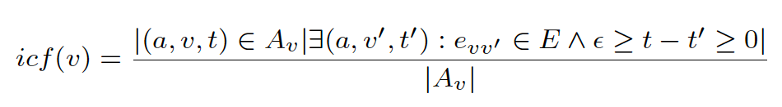
Individual Conformity
The individual conformity represents how easily user v’s behavior conforms to her friends
A specific action performed by user v at time t
Exists a friend v′ who performed the same action at time t’′
All actions by user v
Notes:
The individual conformity is defined as the ratio between the number of actions for which we have evidence that the user v conforms to one of her friends v′, over the total number of actions performed by user v.

Slide 14
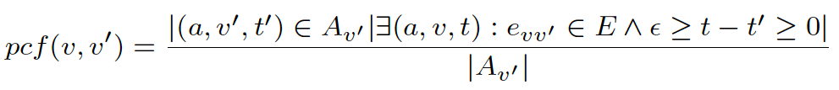
Peer Conformity
The peer conformity represents how likely the user v’s behavior is influenced by one particular friend v′
A specific action performed by user v′ at time t′
User v follows v′ to perform the action a at time t
All actions by user v′
Notes:
The peer conformity is defined as the ratio between the number of actions for which we have evidence that the user v conforms to her friend v′ , over the total number of actions performed by the friend v′

Slide 15
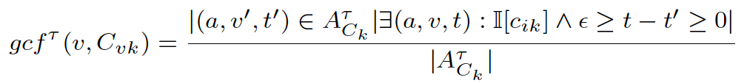
Group Conformity
The group conformity represents the conformity of user v’s behavior to groups that the user belongs to.
τ-group action: an action performed by more than a percentage τ of all users in the group C_{k}
User v conforms to the group to perform the action a at time t
A specific τ-group action
All τ-group actions performed by users in the group C_{k}
Notes:
To begin with, we first define the τ -group action as the action that was performed by more than a percentage τ of all users in the community (group) Ck. Given this, we define the group conformity as follows:
The group conformity is then defined as the ratio between the number of actions for which we have evidence that the user v conforms to the group, over the total number of τ -group actions performed by users in the group Ck,
Please note that a user may be involved into more than one groups, thus has different conformity degrees in the different groups.

Slide 16
For an example
Conformity in the Co-Author Network
KDD
Notes:
We use another example from the Co-Author network to further explain the defined conformity. We calculate how easily authors from different conferences conform to the other authors when publishing their papers. It is interesting. Comparing with ICDM and CIKM, authors from KDD are not least to conform to other authors, while authors from CIKM has a much higher individual conformity.
Further looking at the KDD the conference, the conformity degrees of different years are also different. For example, in 2005, the peer conformity is higher that that in the 2000 and 2010. As for the group conformity, on different topics, authors may have different conformity. For example, in ICDM, authors are easily to conform to the group who are working on “the clustering algorithm”.

Slide 17
Now our problem becomes
How to incorporate the different types of conformities into a unified model?
Input:
G=(V, E, C, X), A
Output:
F: f(G, A) ->Y^{(t+1)}
Notes:
Now our problem becomes how to incorporate the different types of conformities into a unified model?

Slide 18
Confluence
—A conformity-aware factor graph model
Group conformity factor function
Random variable y: Action
Peer conformity factor function
Individual conformity factor function
Notes:
An example is illustrated in Figure 2. In the input network, user v1 belongs to three groups C1, C2, and C3, thus in the constructed factor graph, its corresponding latent variable y1 is connected to three group conformity factors (e.g., g(y1, gcf(v1,C1))). User v1 has four friends in the input network, thus four peer conformity factors in the factor graph model. We also define an individual conformity factor for each user.

Slide 19
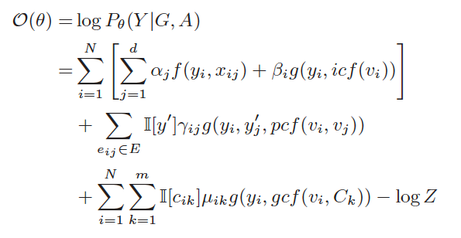



Model Instantiation
Individual conformity factor function
Peer conformity factor function
Group conformity factor function
Notes:
Based on the theory of factor graph model, we can define the following log-likelihood objective function. The decay factor decays
the peer conformity exponentially over time, with the half-life, λ, serving as a tunable parameter.
Besides the conformity actors, we use factor function f(yi, xij) to capture the correlation between the user’s attribute xij and user’s action.
Finally, learning the model is going to estimate the unkown parameters.

Slide 20
General Social Features
Opinion leader^{[1]}
  Whether the user is an opinion leader or not
  Structural hole^{[2]}
  Whether the user is a structural hole spanner
Social ties^{[3]}
  Whether a tie between two users is a strong or weak tie
Social balance^{[4]}
  People in a social network tend to form balanced (triad) structures (like “my friend’s friend is also my friend”).
[1] X. Song, Y. Chi, K. Hino, and B. L. Tseng. Identifying opinion leaders in the blogosphere. In CIKM’06, pages 971–974, 2007.
[2] T. Lou and J Tang. Mining Structural Hole Spanners Through Information Diffusion in Social Networks. In WWW'13. pp. 837-848.
[3] M. Granovetter. The strength of weak ties. American Journal of Sociology, 78(6):1360–1380, 1973.
[4] D. Easley and J. Kleinberg. Networks, Crowds, and Markets: Reasoning about a Highly Connected World. Cambridge University Press, 2010.
Notes:
For a undirected network, there are four types of (un)balanced triads. A binary feature is defined for each of the triad structure. The similar feature definition was also used in [31].

Slide 21
Distributed Model Learning
Unknown parameters to estimate
(1) Master
(2) Slave
(3) Master
Notes:
Learning the Confluence model is to estimate the unknown parameters

Slide 22
Distributed Learning
Master
Global update
Slave
Compute local gradient via random sampling
Graph Partition by Metis
Master-Slave Computing
Inevitable loss of correlation factors!

Slide 23
Experiments

Slide 24
Data Set and Baselines
Baselines
  Support Vector Machine (SVM)
  Logistic Regression (LR)
  Naive Bayes (NB)
  Gaussian Radial Basis Function Neural Network (RBF)
  Conditional Random Field (CRF)
Evaluation metrics
  Precision, Recall, F1, and Area Under Curve (AUC)
Network | #Nodes | #Edges | Behavior | #Actions
Weibo | 1,776,950 | 308,489,739 | Post a tweet | 6,761,186
Flickr | 1,991,509 | 208,118,719 | Add comment | 3,531,801
Gowalla | 196,591 | 950,327 | Check-in | 6,442,890
ArnetMiner | 737,690 | 2,416,472 | Publish paper | 1,974,466

Slide 25
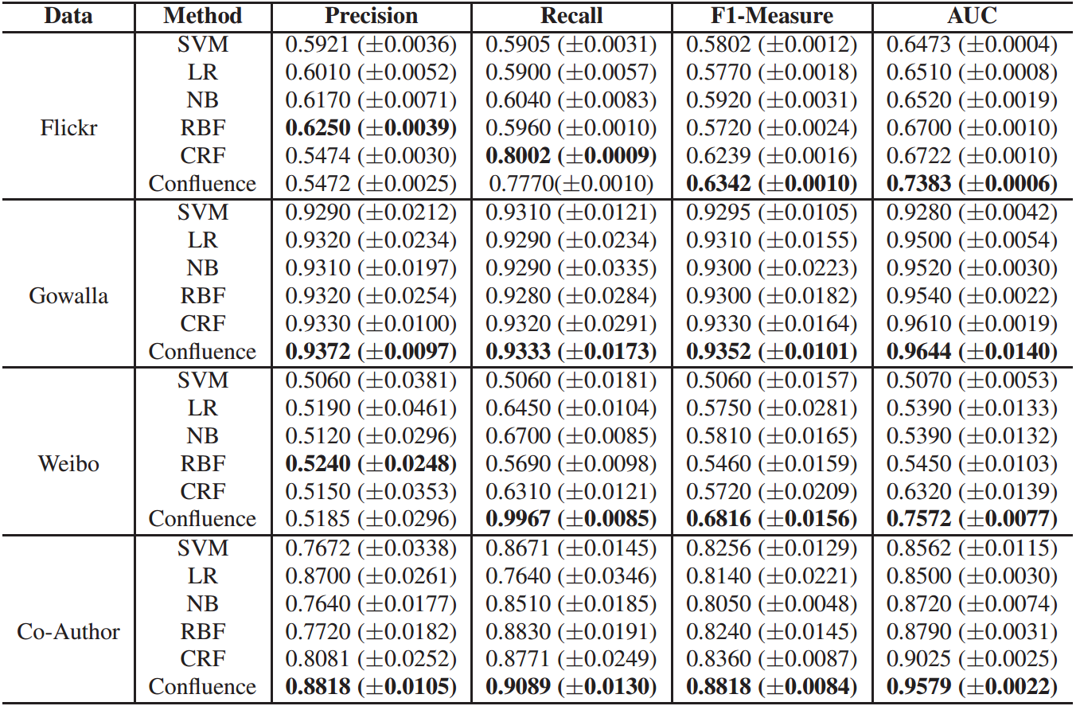
Prediction Accuracy
t-test, p<<0.01

Slide 26
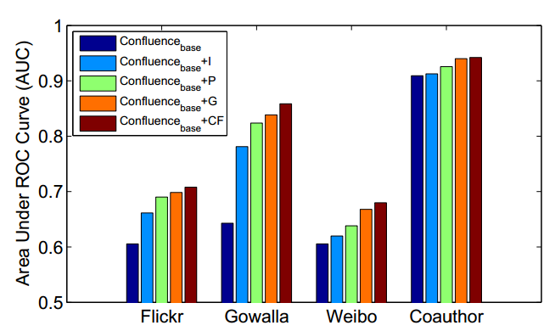
Effect of Conformity
Conﬂuence_{base} stands for the Conﬂuence method without any social based features
Conﬂuence_{base}+I stands for the Conﬂuence_{base} method plus only individual conformity features
Conﬂuence_{base}+P stands for the Conﬂuence_{base} method plus only peer conformity features
Conﬂuence_{base}+G stands for the Conﬂuence_{base} method plus only group conformity
Notes:
We further present an in-depth analysis of how different levels of conformities affect the performance of action prediction. It can be clearly seen that without the conformity based factors, the prediction performance drop significantly. Co-Author network is most predictable because the co-authorships are stable and predictable in general. Weibo and Flickr are the most difficult to predict because the user behavior is fairly autonomous and independent. Conformity has most significant prediction impact on Gowalla, which suggests conformity plays an important role in geospatial and mobile applications in social networks. By incorporating the conformity features, significant improvements (+20-30%) over the prediction performance can be obtained on Gowalla. Confluencebase+I (or +P or +G) respectively indicates that we respectively add individual conformity features (or peer conformity features or group conformity features) into the Confluencebase method. By incorporating each type of conformity factors, we observe clear improvement compared to the Confluencebase method. We can also see that on all the four data sets, the group conformity is more important than the other two types of conformities. This makes sense, as in most cases conformity is a group phenomenon rather than an individual behavior

Slide 27
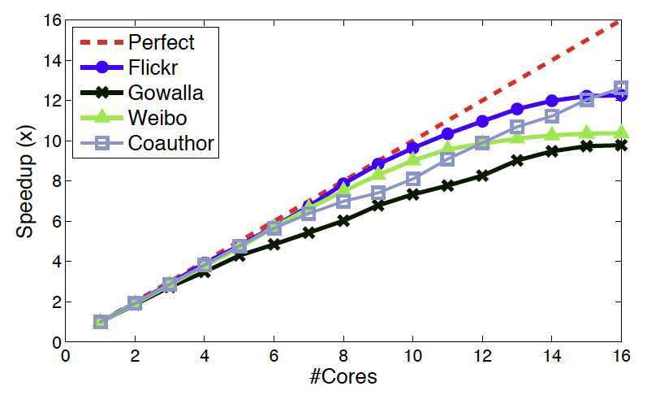
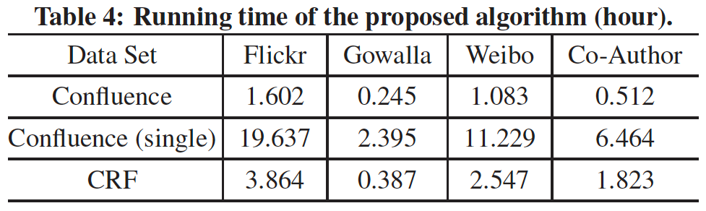
Scalability performance
Achieve ∼ 9×speedup with 16 cores
Notes:
We now evaluate the scalability performance of the distributed learning algorithm on the four networks.
Figure 5 shows the speedup of the distributed algorithm with different number of computer nodes (2, 3, 6, 8, 10, 12, 14, 16 cores) used. The speedup curve is close to the perfect line at the beginning. the distributed learning algorithm can still achieve 9x speedup with 16 cores.

Slide 28
Conclusion
Study a novel problem of conformity inﬂuence analysis in large social networks
Formally deﬁne three conformity functions to capture the different levels of conformities
Propose a Conﬂuence model to model users’ actions and conformity
Our experiments on four datasets verify the effectiveness and efficiency of the proposed model

Slide 29
Future work
Connect the conformity phenomena with other social theories
  e.g., social balance, status, and structural hole
Study the interplay between conformity and reactance
Better model the conformity phenomena with other methodologies (e.g., causality)
Notes:
connect the conformity phenomenon with some other social theories such as social status and structural holes so as to understand the formation and dynamic change of the network
structure.
It is also interesting to design some other model, for example a game theory based model, to model the conformity phenomenon. As for the proposed Confluence model itself, it has many parameters. We also consider adding regularization to control the sparsity of those parameters.

Slide 30
Confluence: Conformity Influence in Large Social Networks
Jie Tang*, Sen Wu*, and Jimeng Sun⁺
*Tsinghua University
⁺IBM TJ Watson Research Center
Data and codes are available at: http://arnetminer.org/conformity/

Slide 31
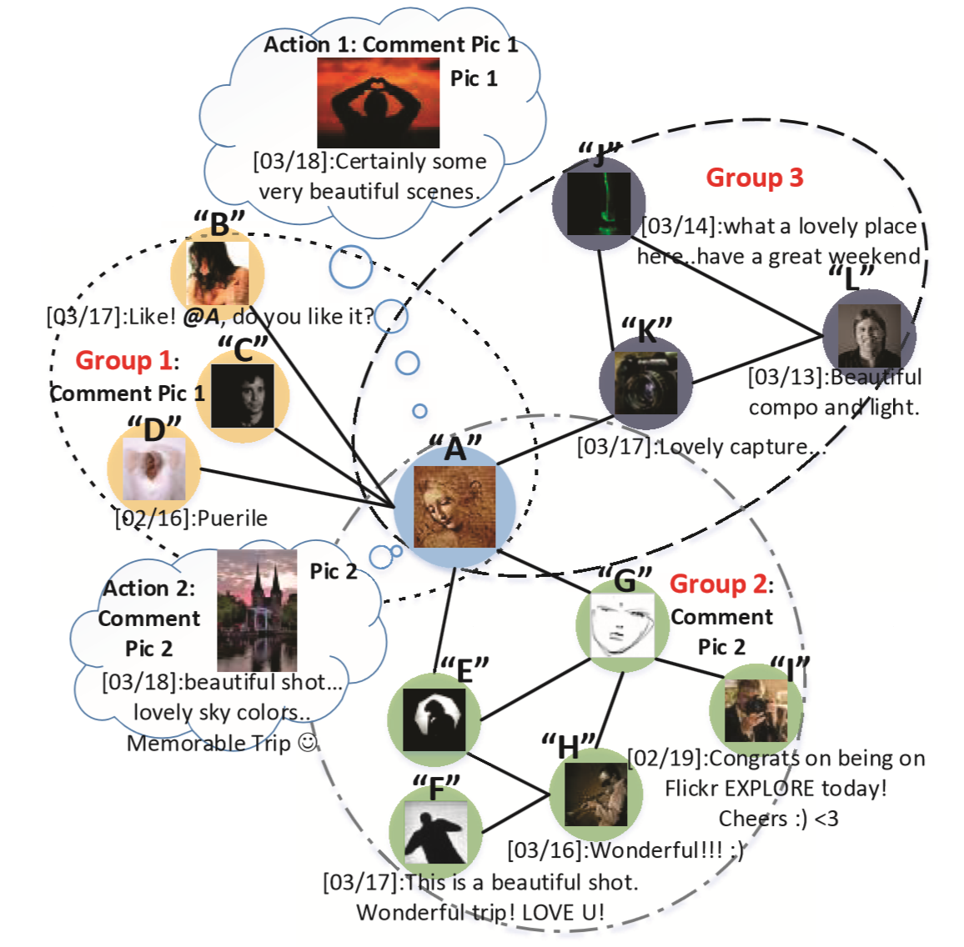
Qualitative Case Study

Slide 32
I love Obama
Positive
Negative
1. Peer Conformity
1
2. Individual Conformity

Slide 33
I love Obama
Positive
Negative
Obama is great!
1. Peer conformity
2
2. Individual Conformity

Slide 34
I love Obama
Positive
Negative
Obama is great!
1. Peer conformity
3
2. Individual conformity

Slide 35
I love Obama
Positive
Negative
3. Group conformity
Obama is fantastic
Obama is great!
1. Peer conformity
4
2. Individual conformity

